Slide 1
Module 3
Chapter 2
SQL

Slide 2
SQL
SQL uses the terms table, row, and column for the formal relational model terms relation, tuple, (a single row or record in a database table) and attribute, respectively. The main SQL command for data definition is the CREATE statement, which can be used to create schemas, tables (relations), domains (a data type that’s defined with constraints) , views, assertions(Assertions are used to ensure data integrity and prevent invalid data entry) and triggers.

Slide 3
Schema and Catalog Concepts in SQL
An SQL schema is identified by a schema name, and includes an authorization identifier to indicate the user or account who owns the schema, as well as descriptors for each element in the schema. Schema elements include tables, constraints, views, domains, and other constructs (such as authorization grants) that describe the schema. A schema is created via the CREATE SCHEMA statement .(A list of logical structures of data is know as schema. )
For example, the following statement creates a schema called COMPANY
CREATE SCHEMA COMPANY;
SQL uses the concept of a catalog a named collection of schemas in an SQL environment.

Slide 4
Data Types
Data type of a column defines what value the column can store in table.
Defined while creating tables in database.
Most used
String: char, varchar.
Numeric: int, float, dec.
Date and time: date, datetime.

Slide 5
Commonly used data types in SQL:
Numeric data types includes
int: used for the integer value
float: used to specify a decimal point number.
dec(i,j) or numeric(i,j): used to specify a decimal point number.
i- precision, total number of decimal digits
j- scale, number of digits after the decimal point.
Boolean data type
bool: used to specify Boolean values true and false.

Slide 6
Character data types
Char: fixed length string that can contain numbers, letters and special characters.
Varchar: variable length string that can contain numbers, letters and special characters.
Date data type
date: date format YYYY-MM-DD
Time data type
time: time format HH:MM:SS
datetime: date and time combination format is YYYY-MM-DD HH:MM:SS

Slide 7
The CREATE TABLE Command in SQL For creating tables we use CREATE TABLE statement. Example: CREATE TABLE students(usn varchar(10) primary key, name varchar(50) not null, semester int not null, address varchar(100)); CREATE TABLE courses(course_id int primary key, course_title varchar(50) , credits int);

Slide 8
Specifying Constraints in SQL
Constraints are used to specify rules for data in a table.
This ensures the accuracy and reliability of the data in the table.
Constraints can be specified when the table is created .
Basic constraints that can be specified in SQL as part of table creation:
key and referential integrity constraints
Attribute Constraints and Attribute Defaults

Slide 9
Specifying key and referential integrity constraints
Primary key(PK):
A Primary key is a unique column we set in a table to easily identify and locate data in queries.
A table can have only one primary key, which should be unique and NOT NULL.
A combination of a NOT NULL and UNIQUE.
unique identifier for each row in a table.
Each table can have only one primary key.

Slide 10
Foreign key
A foreign key is a column used to link two or more tables together
A table can have any number of foreign keys, can contain duplicate and NULL values.
Connects data in one table to data in another table.
Data consist between tables(referential integrity constrain).
In one table can have multiple foreign key.
Foreign key contain duplicate values.

Slide 11
Unique: Ensures that all values in the column are different
Primary key
Primary key on a column is used to identify the records in a table uniquely.
No Duplicate entries are allowed.
Cannot contain “NULL” values.
A table can have only one primary key.
Used to serve as a unique identifier for each row in a table.
Unique
Unique key on a column is used to identify the records in a table uniquely.
No Duplicate entries are allowed.
Can contain one “NULL” values.
A table can have more then one unique key.
Uniquely determines a row which isn’t primary key.

Slide 12
Specifying Attribute Constraints and Attribute Defaults
NOT NULL: ensures that column cannot have a NULL values.
The not null constraint can be used to ensure that a column cannot store a NULL value. This means that all inserts and updates to the column must specify a value. Attempting to insert or update a NULL value will result in an error.
Example:
CREATE DATABSE course;
Use course;
Create table students(usn varchar(10) primary key, name varchar (50) not null, semester int not null, address varchar(100));

Slide 13
DEFAULT: Sets a default value for a column if no value is specified.
It acts as a backup plan.
Syntax: DEFAULT default _value.
Example:
CREATE TABLE employee(emp_id int PRIMARY KEY, name varchar(10), age int, status varchar(10) DEFAULT ‘active’);
Insert into employee values( 1, ‘Vinutha’, 26);
Insert into employee values(2, ‘Rakshitha’, 24, ‘Inactive’);
Emp-id | Name | Age | status
1 | Vinutha | 26 | active
2 | Rakshitha | 24 | Inactive

Slide 14
CHECK constrain on a column is used to define condition to check the values being entered is the column. If the values entered do not satisfy the condition then it is not updated in table and throws an error .
Ensures that the values in a column satisfies a specific condition.
Can set conditions that must be met before data can be added or updated.
To maintain data consistency.
Syntax: CHECK(condition)
Example:
Create table employee(emp_id int primary key, emp_name varchar(40), age int, constraint age_check(age>=21));
Insert into employee values(1, ‘neha’, 20);
Output:
Error: CHECK constraint failed: age_check

Slide 15
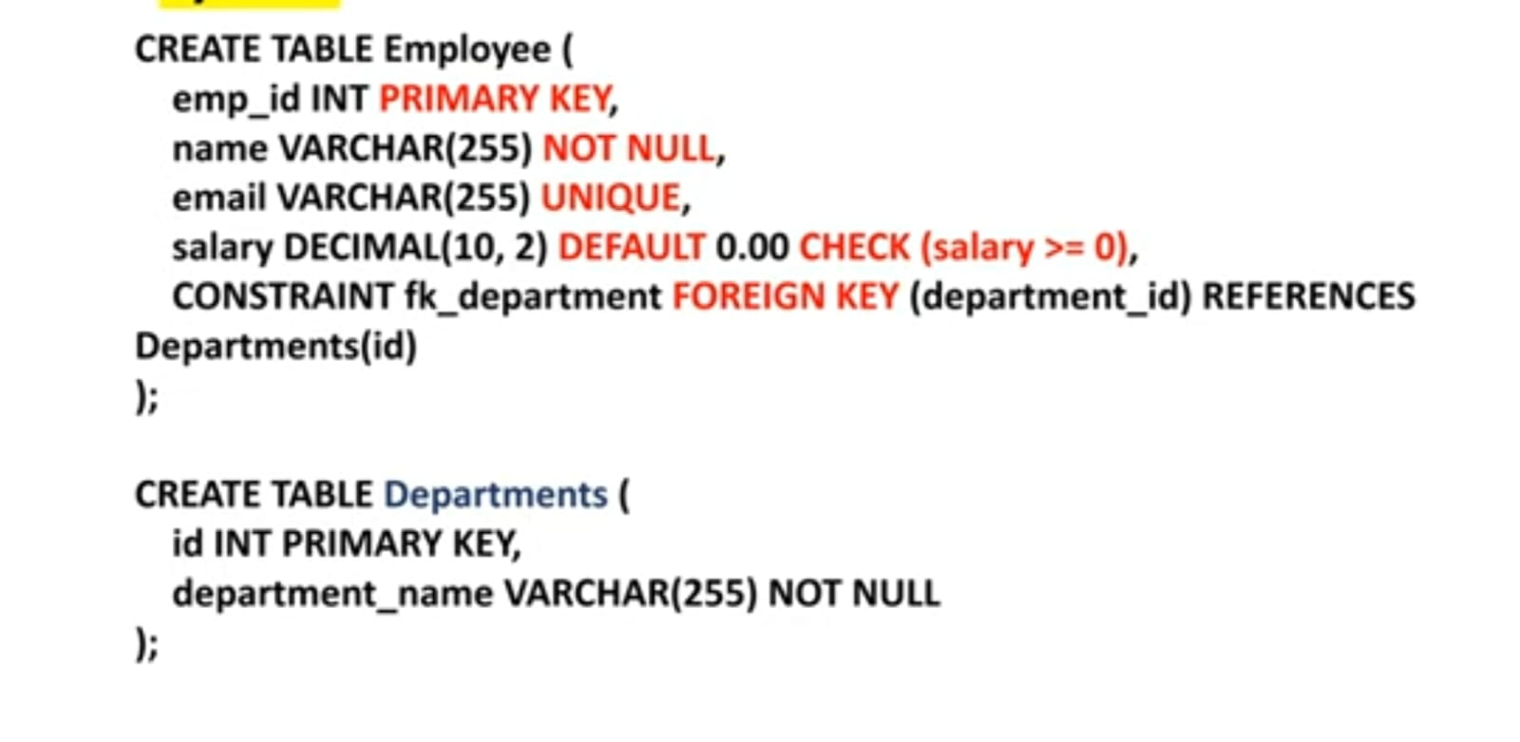

Slide 16
Basic Retrieval Queries in SQL SQL has one basic statement for retrieving information from a database: the SELECT statement. The SELECT-FROM-WHERE Structure of Basic SQL Queries SELECT: choose columns FROM: identify tables WHERE: filter rows DISTINCT: eliminate duplicate

Slide 17
SELECT statement
The SELECT statement is used to select data from a database.
Syntax: SELECT column_name FROM table_name;
To select all the fields available in the table.
Syntax: SELECT * FROM table_table;
* is used to select all data in the table that has been inserted.
To select distinct/unique fields available in the table.
Syntax: SELECT DISTINCT column_name FROM table_name;

Slide 18
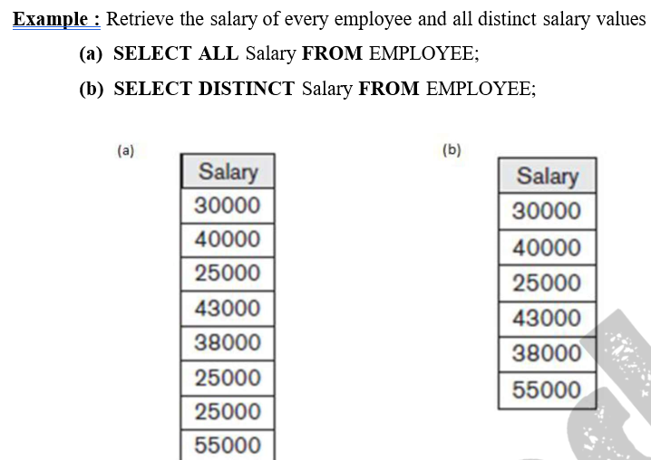

Slide 19
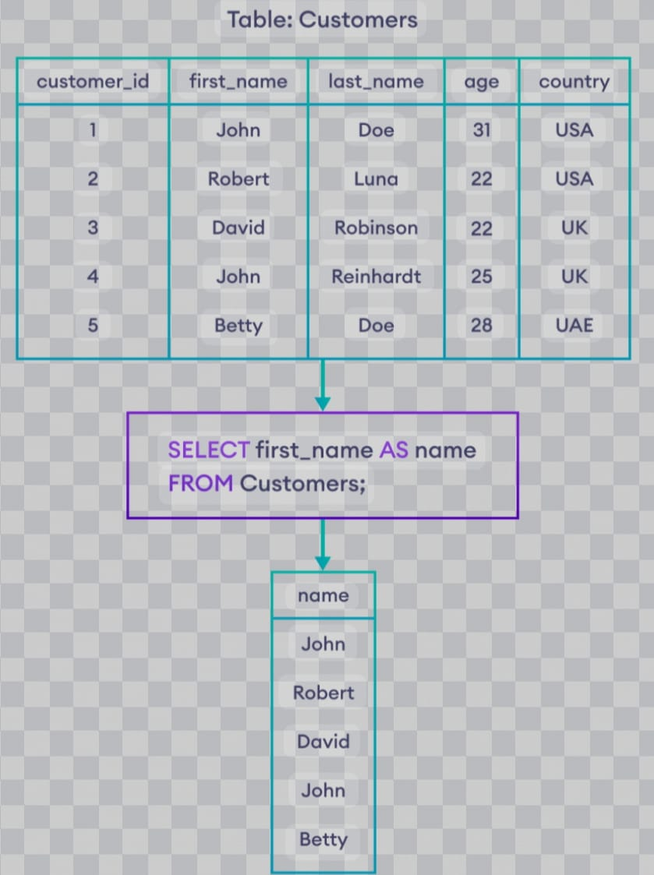
Alias of an Attribute
Alias is also know as Renaming.
Aliasing an attribute, in various contexts, means defining an alternative name or mapping for an attribute.

Slide 20
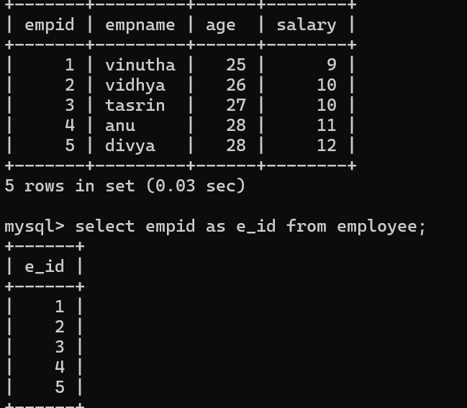
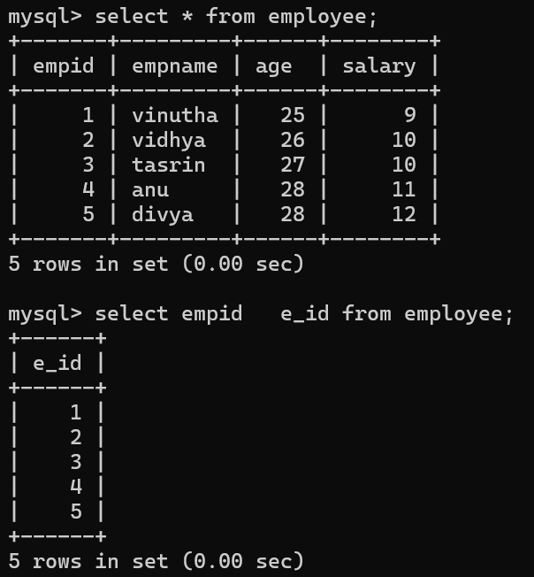

Slide 21
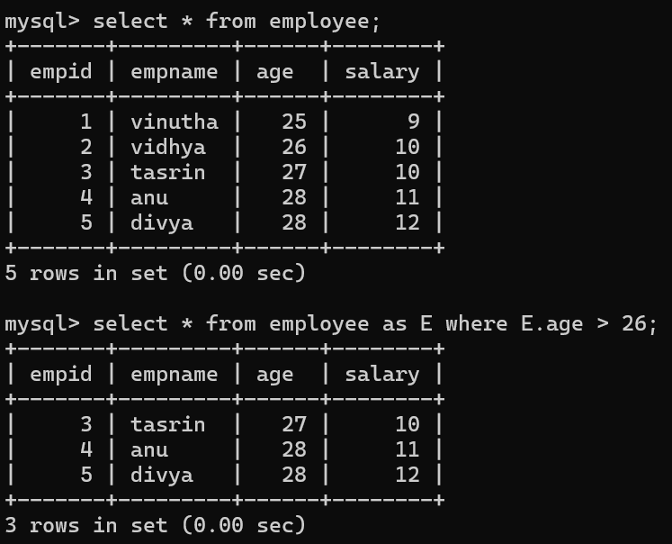

Slide 22
Renaming and having an alias for a table are completely different things.
Renaming will change the name of the table in the database, and the table will forever be referenced by that new name.
ALTER RENAME TABLE {tbl_name} TO {new_tbl_name};
An alias however, is a sort of placeholder.
SELECT first_name AS Name FROM student_details;
When you run this query, it will return you a column of “first_name” from the table student_details - but the column in the display only will be names as Name.

Slide 23
Ambiguous Attribute names ,Aliasing, Renaming and Tuple Variables
Tuple Variables
Tuple variables are used in databases to hold multiple values in a single variable. They are often used to group related data together.
Attribute Names
In databases, attribute names refer to the names given to the columns or fields in a table. These names help identify and differentiate the data stored in the table.

Slide 24
Aliasing and Renaming
Aliasing and renaming are techniques used in databases to give different names to tables or columns in order to make the query or code more readable and understandable.
Ambiguous Attribute Names
Ambiguous attribute names occur when two or more tables contain columns with the same name. This can cause confusion and errors when writing queries, and aliases or renaming can be used to resolve the ambiguity

Slide 25
Where Clause
The WHERE clause is used to filter records.
It is used to extract only those records that fulfil a specified condition
Syntax
SELECT column_name FROM table_name WHERE CONDITION;
Example
SELECT name FROM classroom WHERE grade=‘A’;
In output we can see only students who are having grade A .
empid | empname | salary
E1 | Kishore | 12000
E2 | Ravi | 18000
E3 | Sudha | 12000
SELECT * FROM employee WHERE empname=‘Ravi’;
OUPUT:
empid | empname | salary
E2 | Ravi | 18000

Slide 26
Tables as sets in SQL
SQL usually treats a table not as a set but rather as a multiset; duplicate tuples can appear more than once in a table, and in the result of a query. SQL does not automatically eliminate duplicate tuples in the results of queries, for the following reasons:
Duplicate elimination is an expensive operation. One way to implement it is to sort the tuples first and then eliminate duplicates.
The user may want to see duplicate tuples in the result of a query.
When an aggregate function is applied to tuples, in most cases we do not want to eliminate duplicates.

Slide 27
If we do want to eliminate duplicate tuples from the result of an SQL query, we use the keyword DISTINCT in the SELECT clause, meaning that only distinct tuples should remain in the result.
To select distinct/unique fields available in the table.
Syntax: SELECT DISTINCT column_name FROM table_name;

Slide 29
SQL has directly incorporated some of the set operations from mathematical set theory, which are also part of relational algebra. There are
set union (UNION)
set difference (EXCEPT) and
set intersection (INTERSECT)

Slide 30

Set Operators
Set Operators allow you to combine the results of to or more SELECT (queries) statements into a single result set based on set theory principles.
These operators allow you to perform operations such as combining, intersecting or subtracting sets of data.

Slide 31
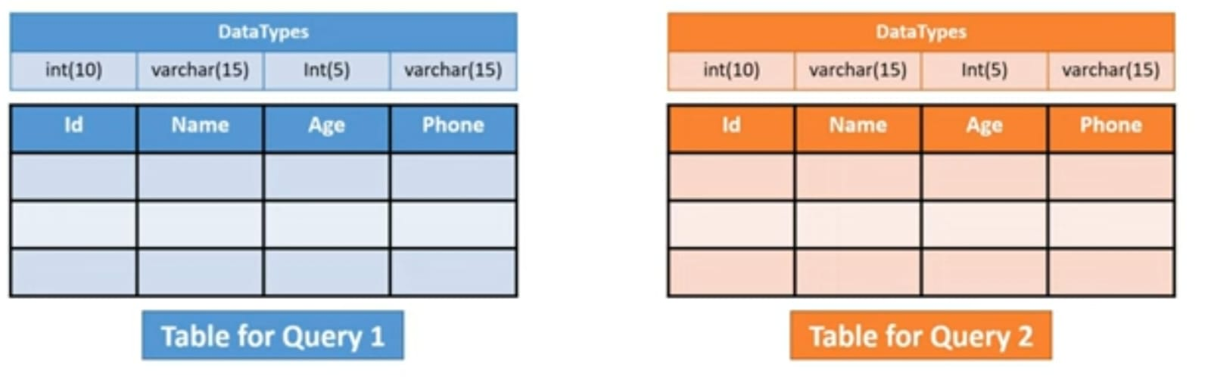
Rules to use set operators
Every SELECT statement must have the same number of columns.
The columns must also have similar data types.
The columns in every SELECT statement must also be in the same order.

Slide 32


Slide 33
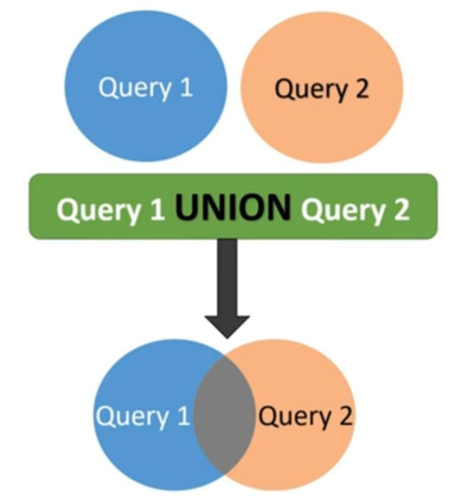
UNION
The union operator combines the result sets of two or more SELECT statements into a single result set.
It removes duplicate rows from the result set.
Here with the select statement we can add where clause according to the input.

Slide 34
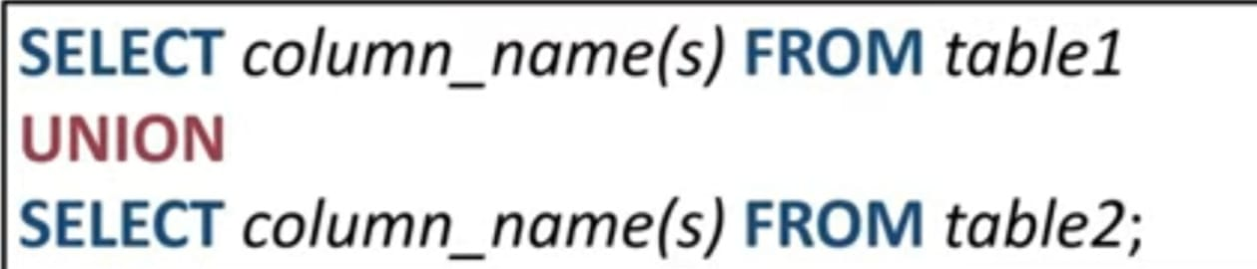
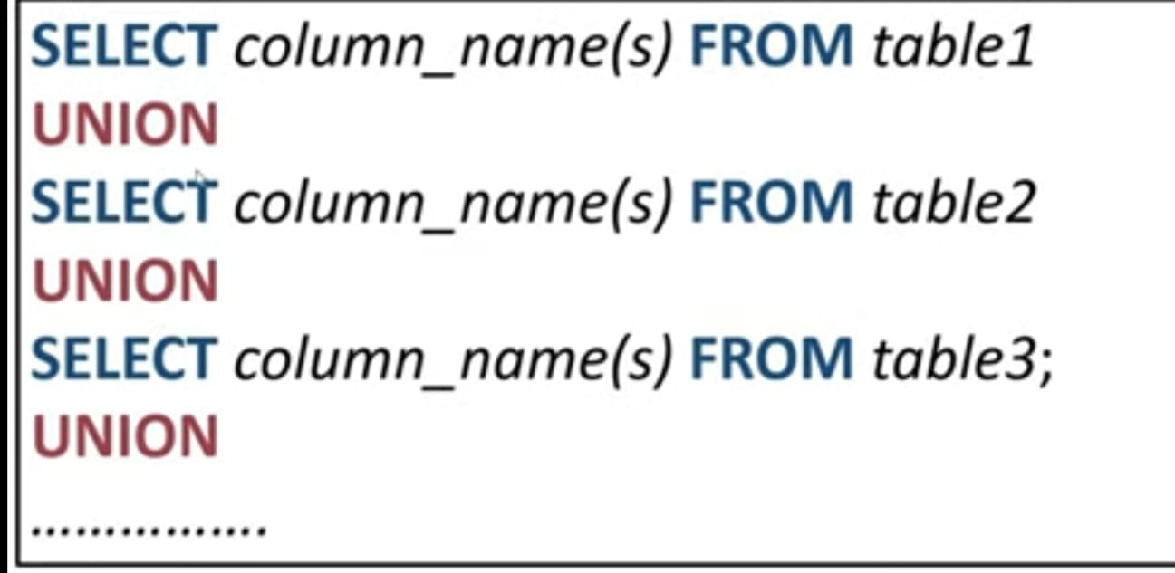
Syntax

Slide 35
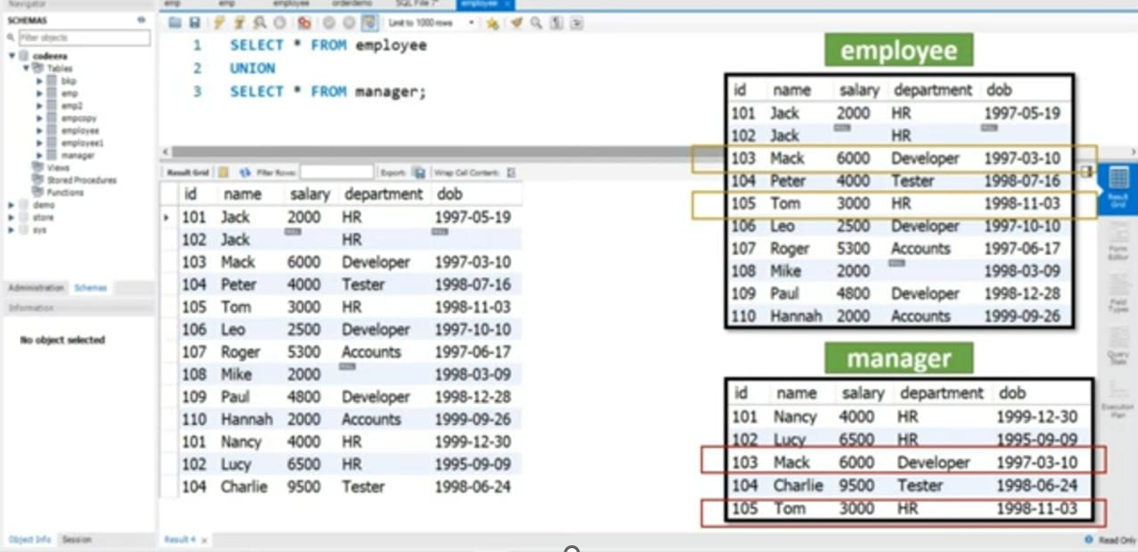
Write a SQL query to return all the details of the employees from the employee and manager table.

Slide 36
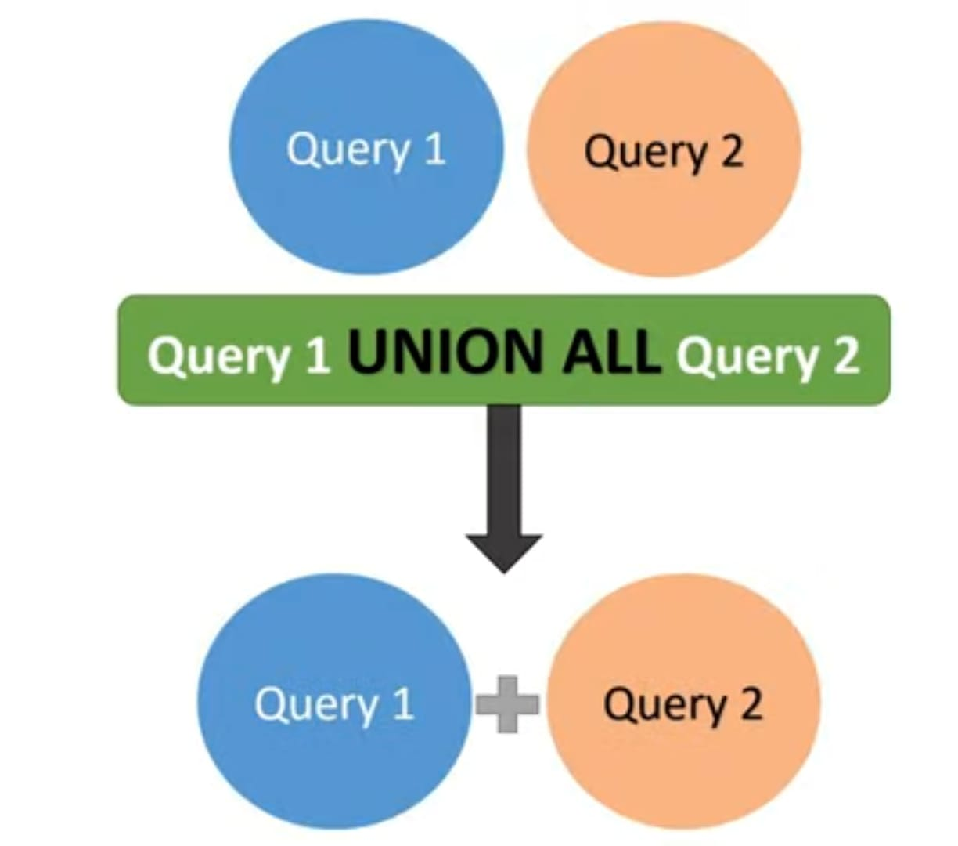
Union all
UNION ALL operator is used to combine the result sets of two or more SELECT statements into a single result set.
It retains all rows from all SELECT statements, including any duplicates.

Slide 37

Syntax

Slide 38
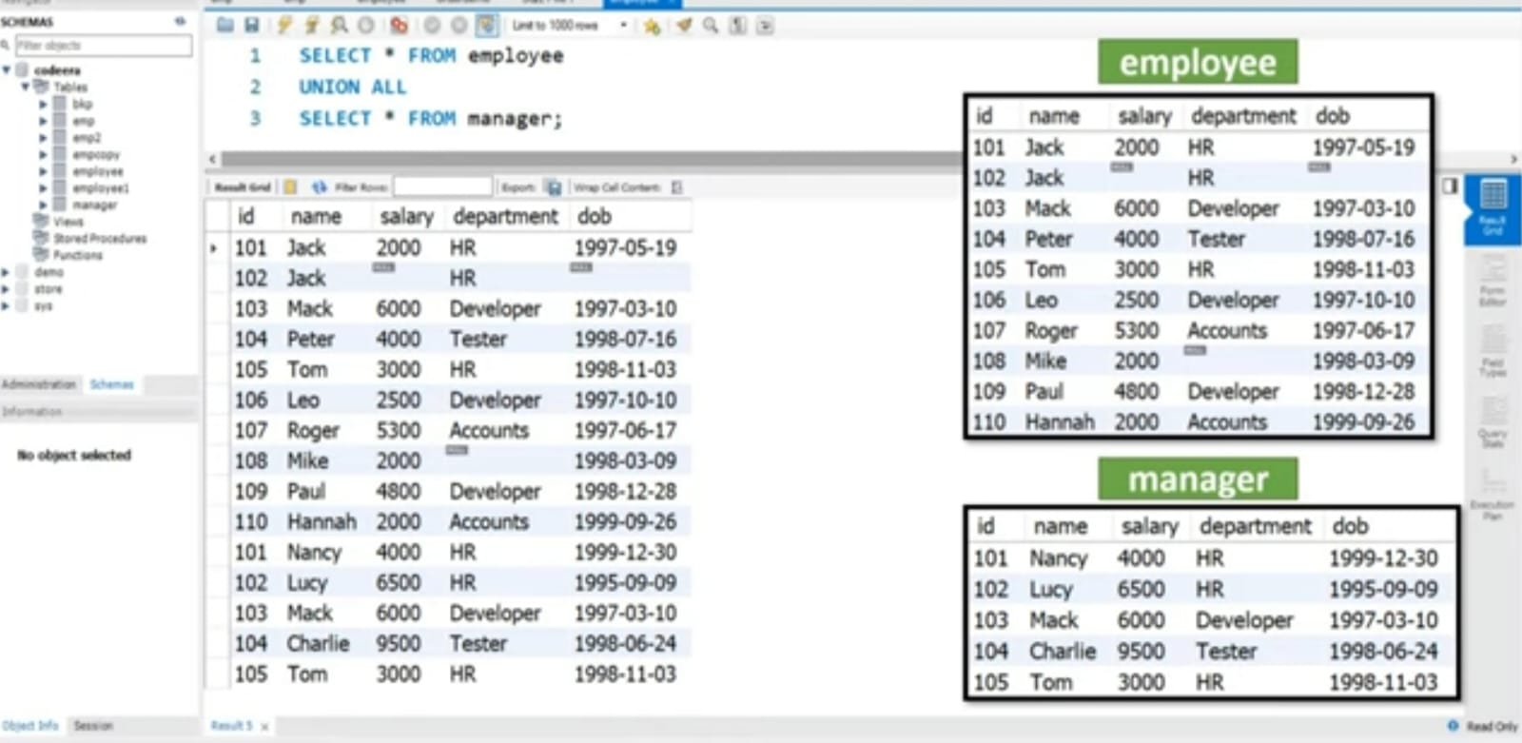
Write a SQL query to return all the details of the employees from the employee and manager table.

Slide 39
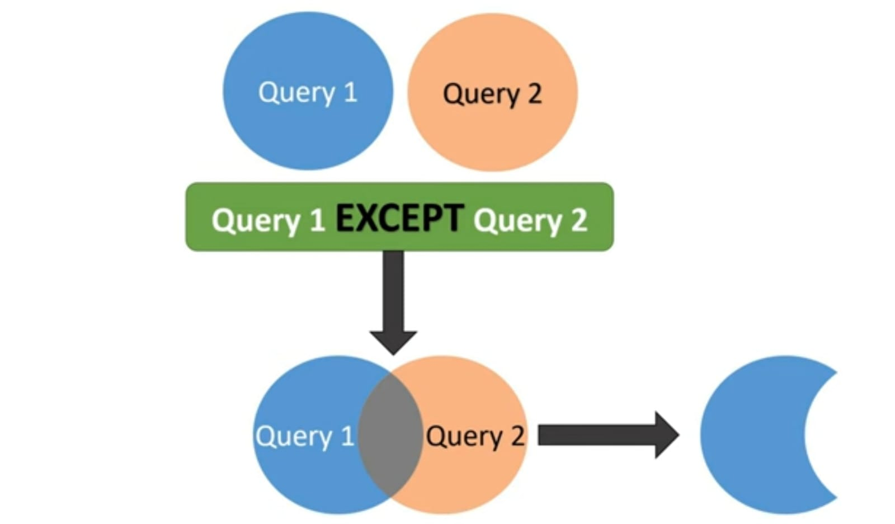

EXCEPT or MINUS
The EXCEPT operator returns rows from the result set of the first SELECT statement that are not present in the result set of the second SELECT statement.

Slide 40
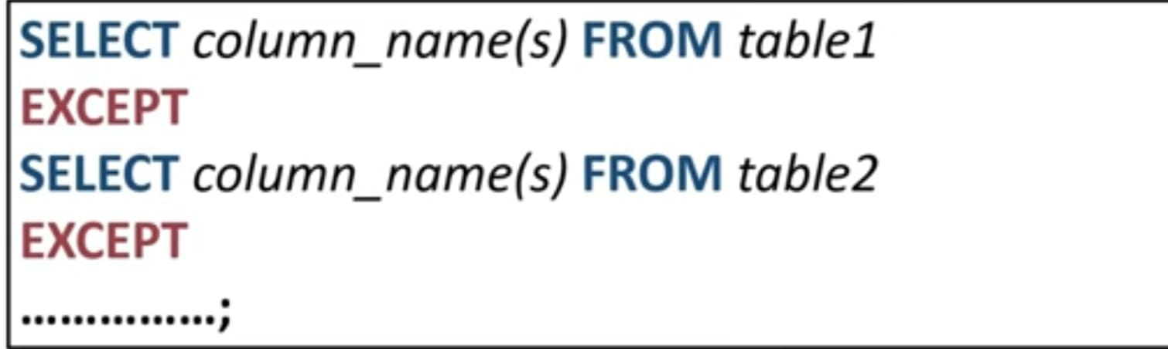
Syntax

Slide 41
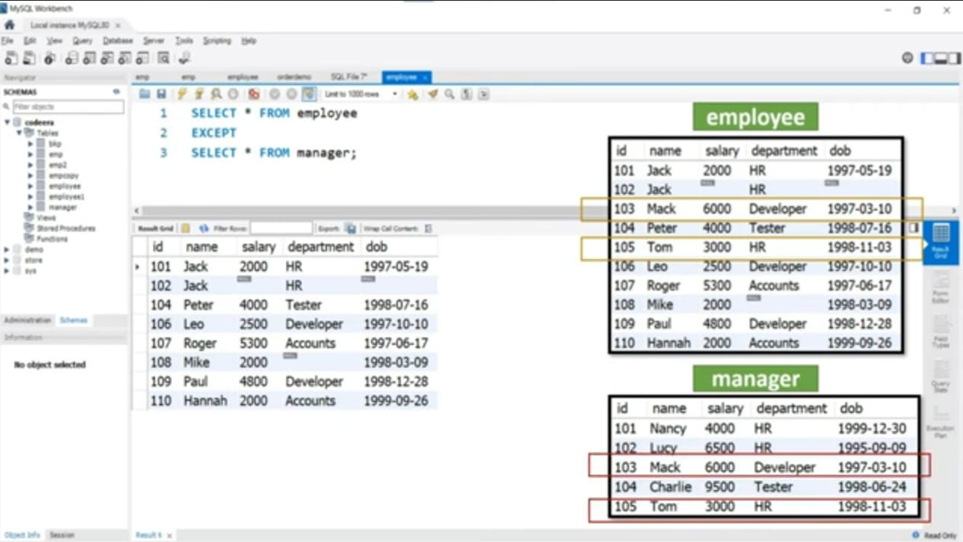
Write a SQL query to fetch all the details of the employees who are not manager from the employee table.

Slide 42
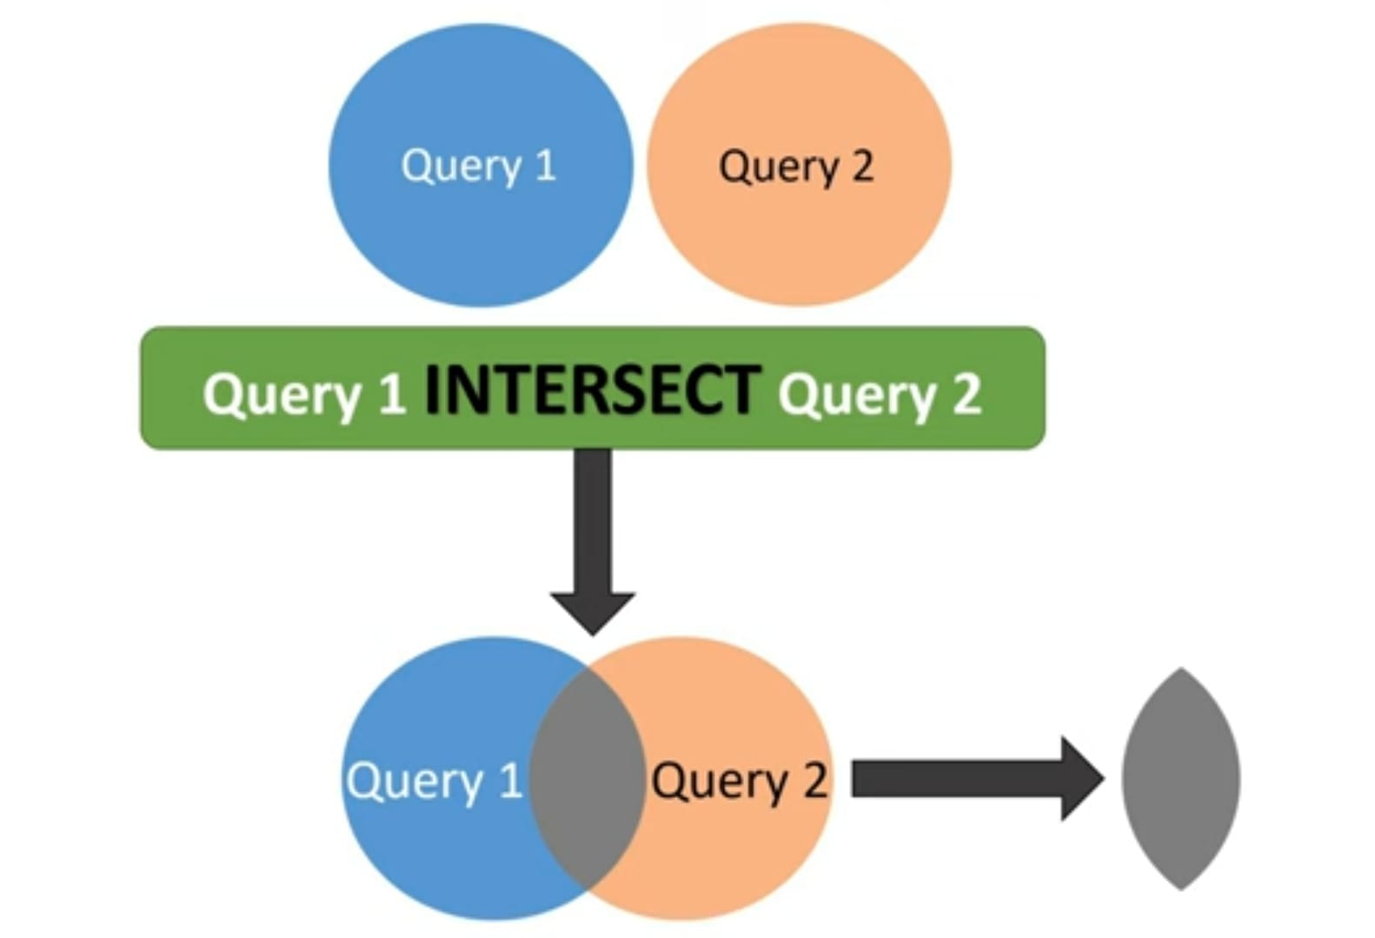
INTERSECT
The INTERSECT operator returns the common rows between the result sets of two or more SELECT statements.
It only includes rows that appear in all the results sets.

Slide 43
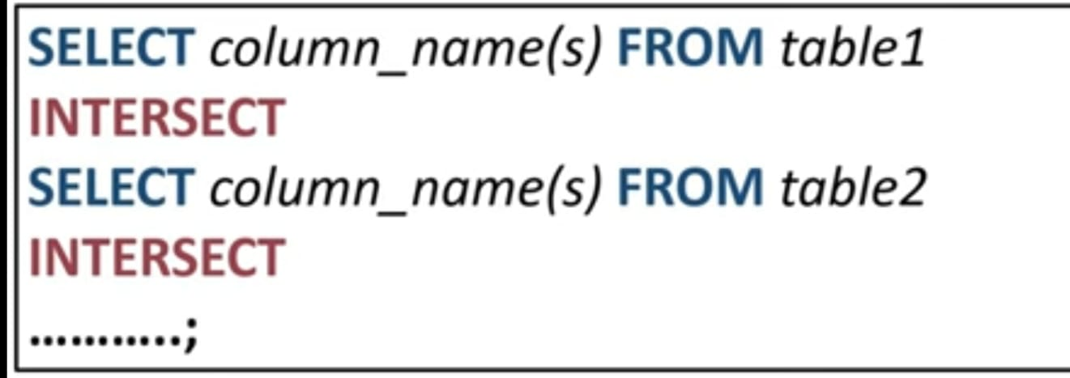
Syntax

Slide 44
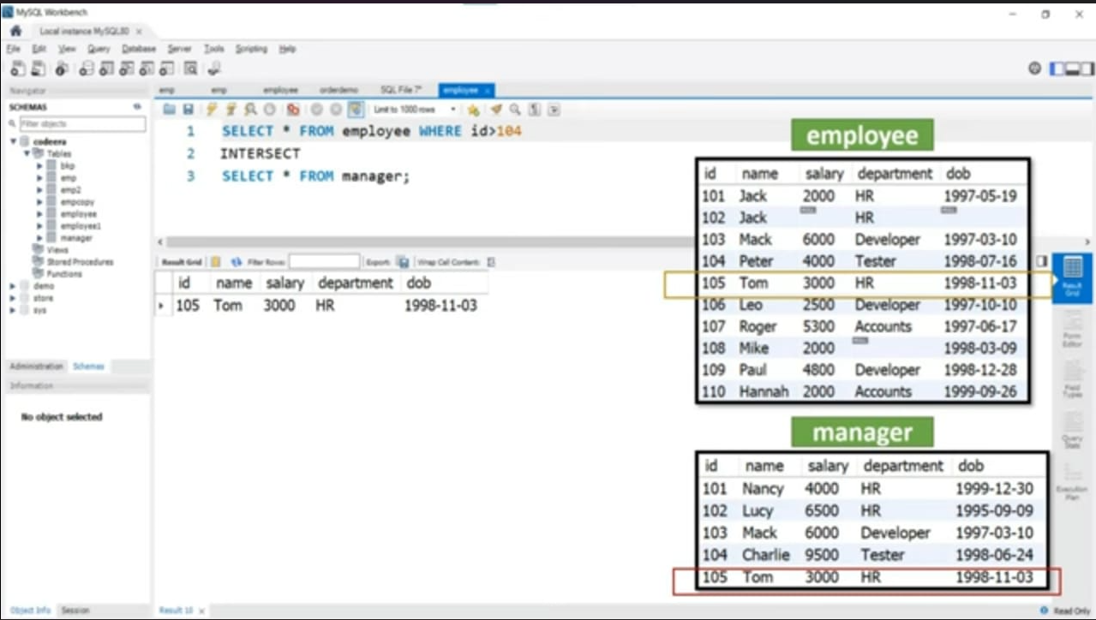
Write a SQL query to return all the details of the employees from the employee table who are manager

Slide 45
Substring Pattern Matching and Arithmetic Operators
The first feature allows comparison conditions on only parts of a character string, using the LIKE comparison operator. This can be used for string pattern matching. Partial strings are specified using two reserved characters:
% replaces an arbitrary number of zero or more characters
_ (underscore) replaces a single character

Slide 46
LIKE in SQL
The LIKE operator is used with WHERE clause to get a result set that matches the given search pattern in a column.(WHERE is used to filter the record based on the condition).
LIKE operator can be use in the WHERE clause of a SELECT, INSERT, UPDATE OR DELETE statement.
LIKE is used to search for a specific pattern in a column.

Slide 47
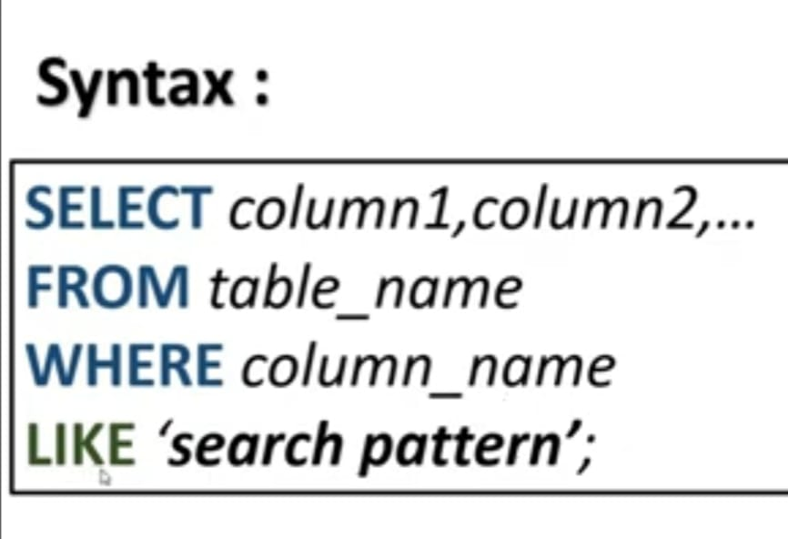
Advantages
Improves the performance of an application.
Saves time in filtering records from the table.

Slide 48
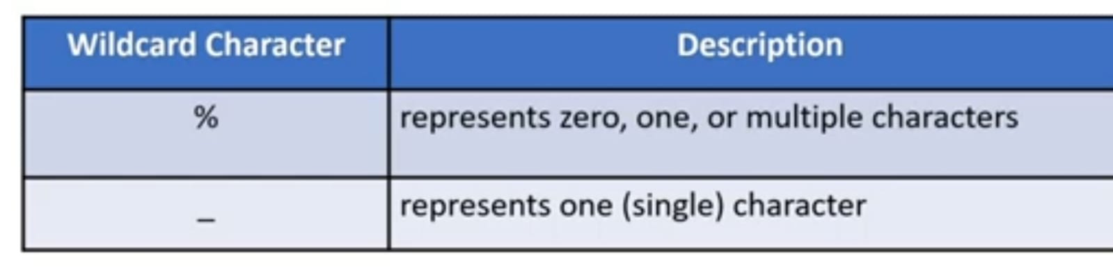
Search Pattern
A search condition made up of literal text, wildcard characters or any combination of both.
Wildcard Characters
There are two wildcards used with Like operator.
The percent sign and the underscore can be used in combinations.

Slide 49
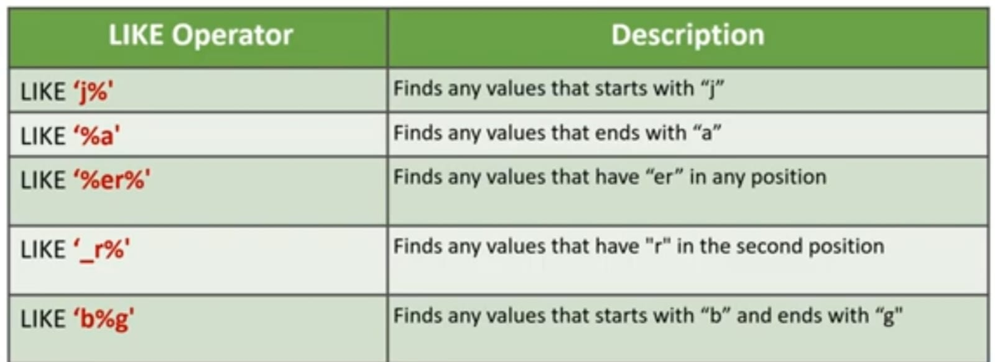

Slide 50
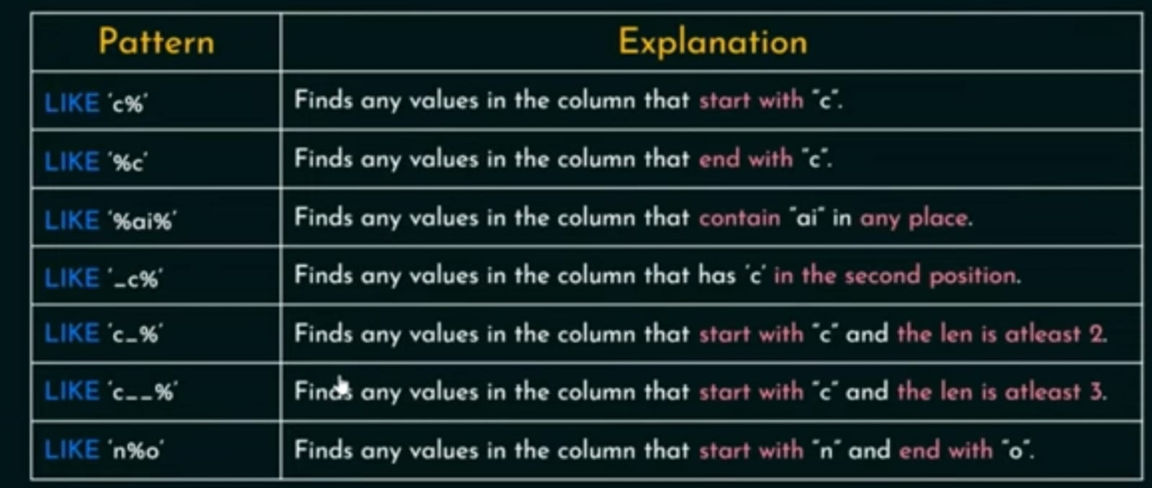

Slide 51
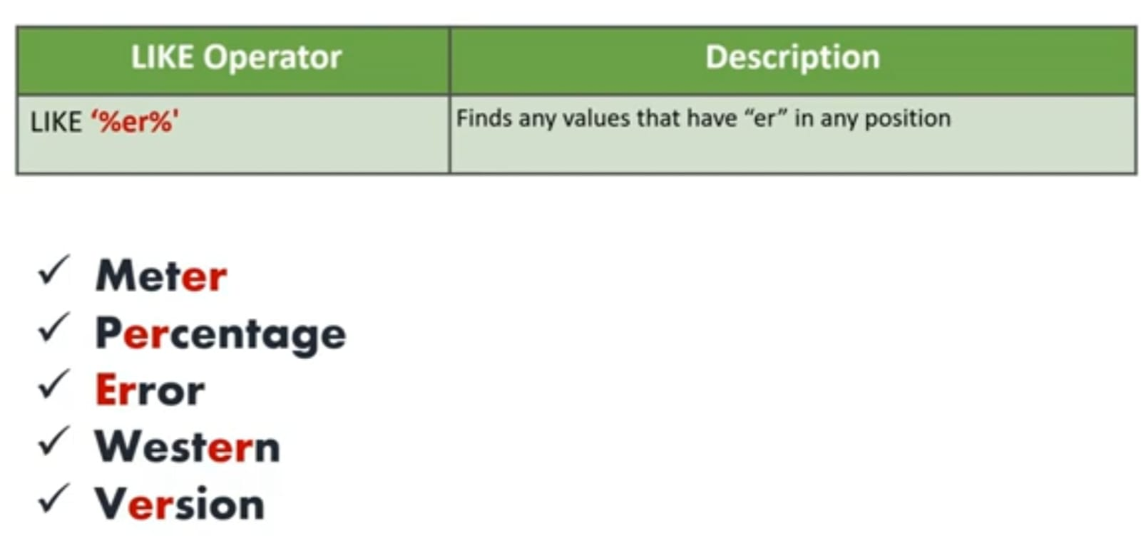
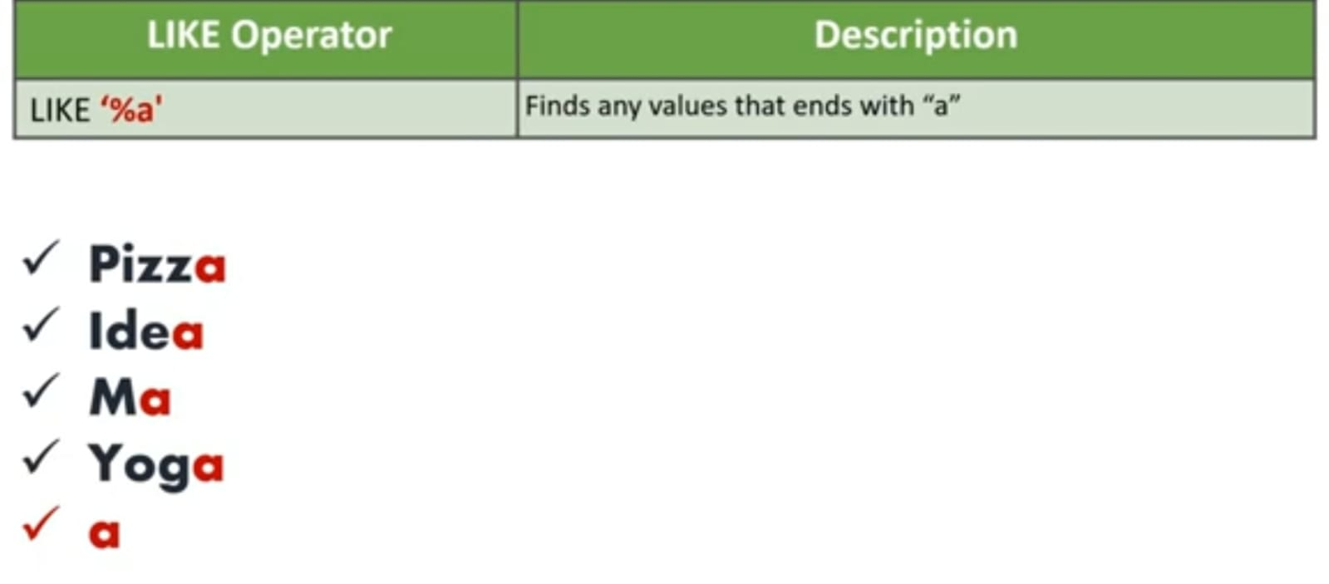

Slide 52
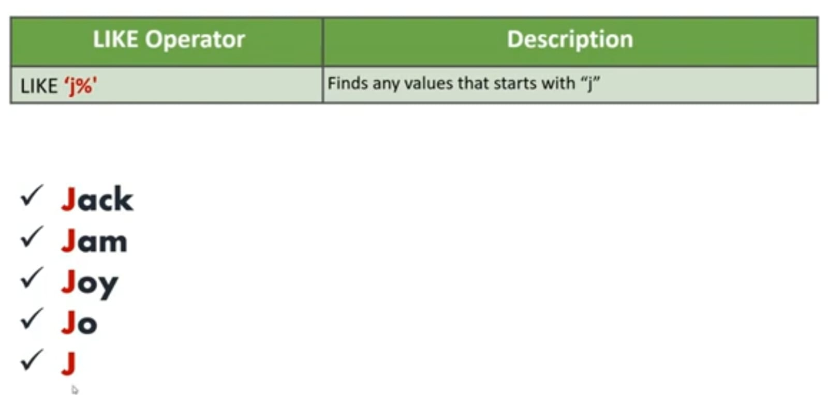
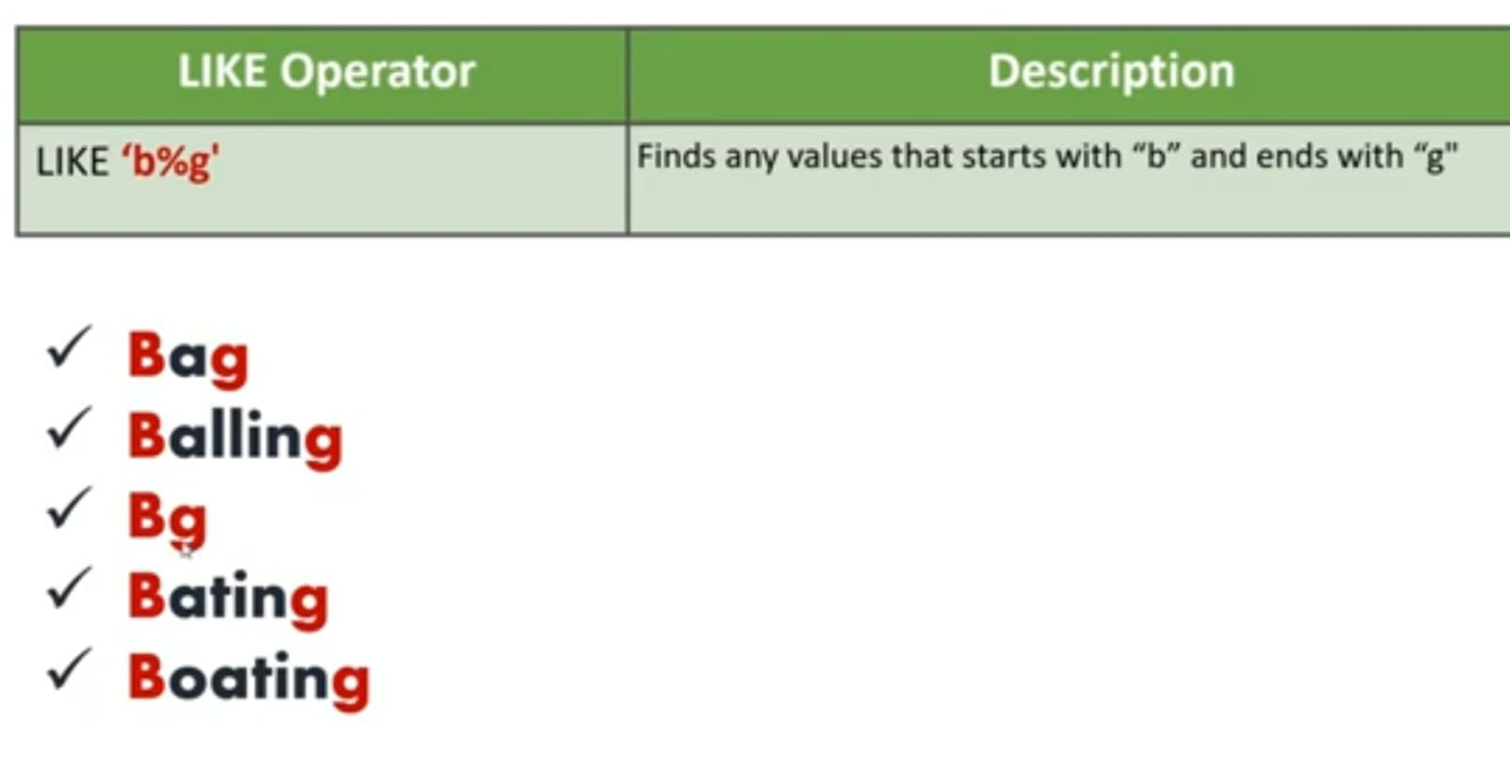

Slide 53
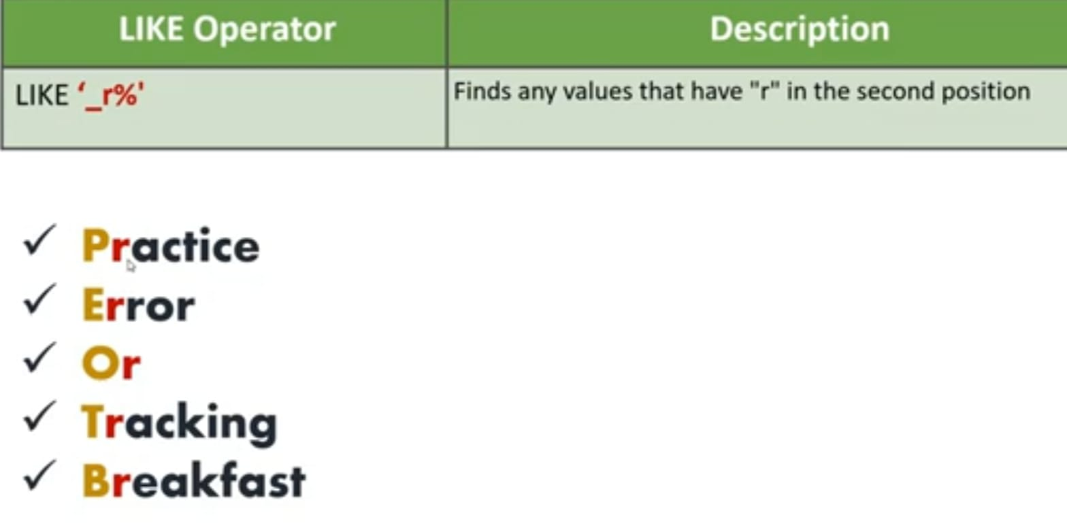

Slide 54
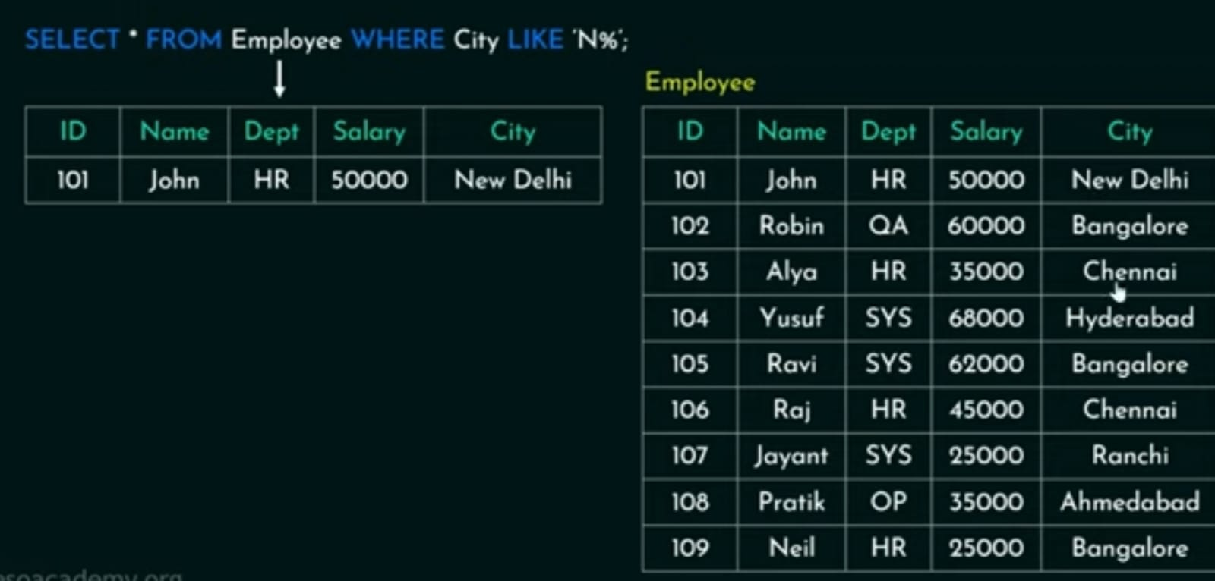

Slide 55
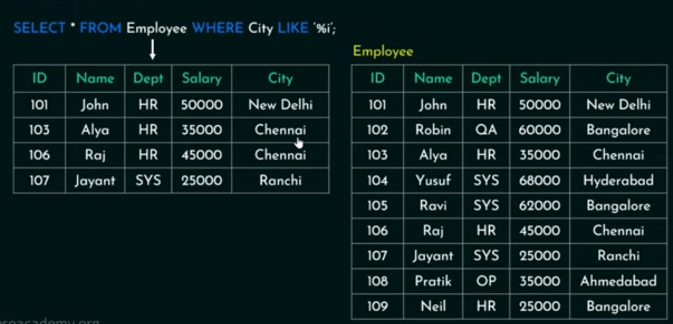

Slide 56
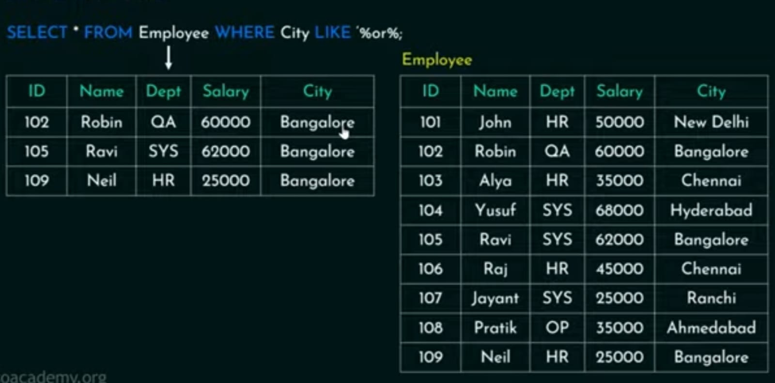

Slide 57
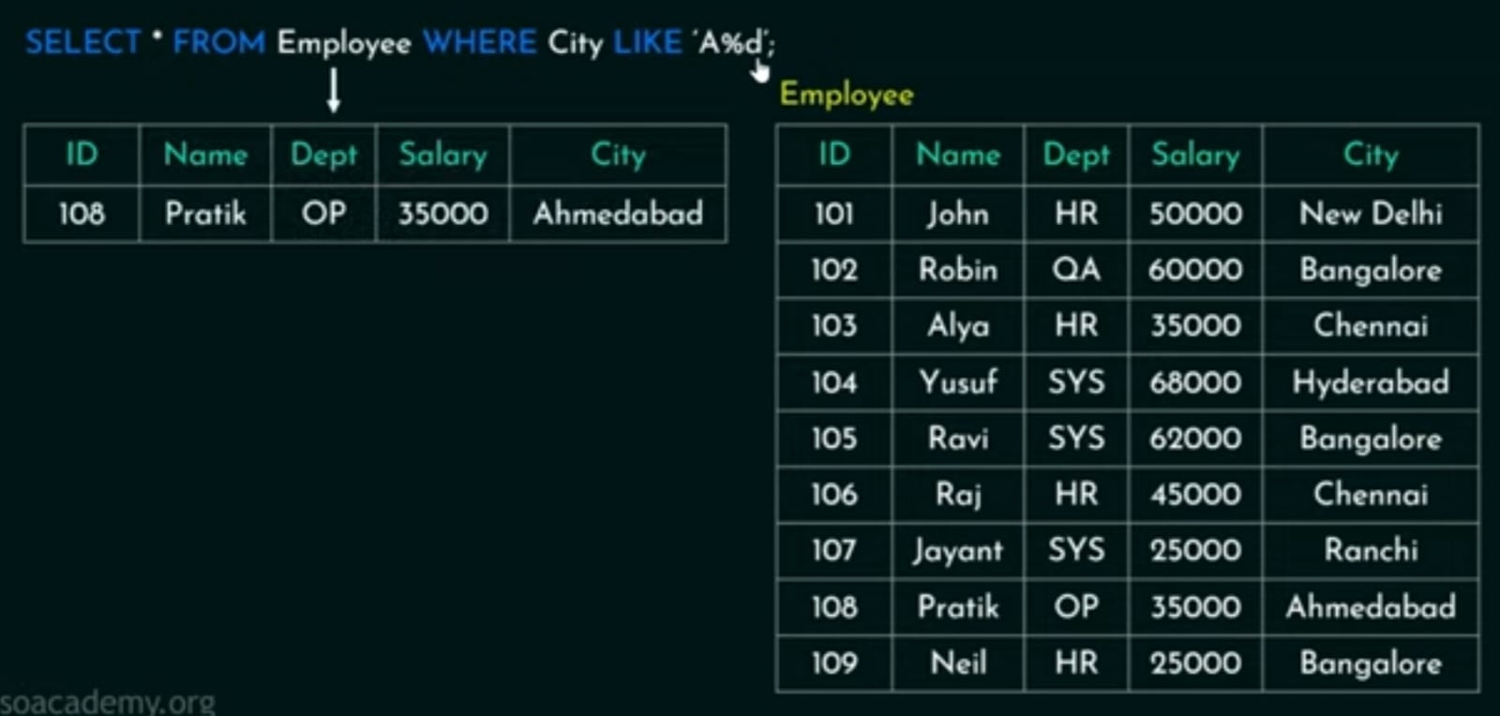

Slide 58
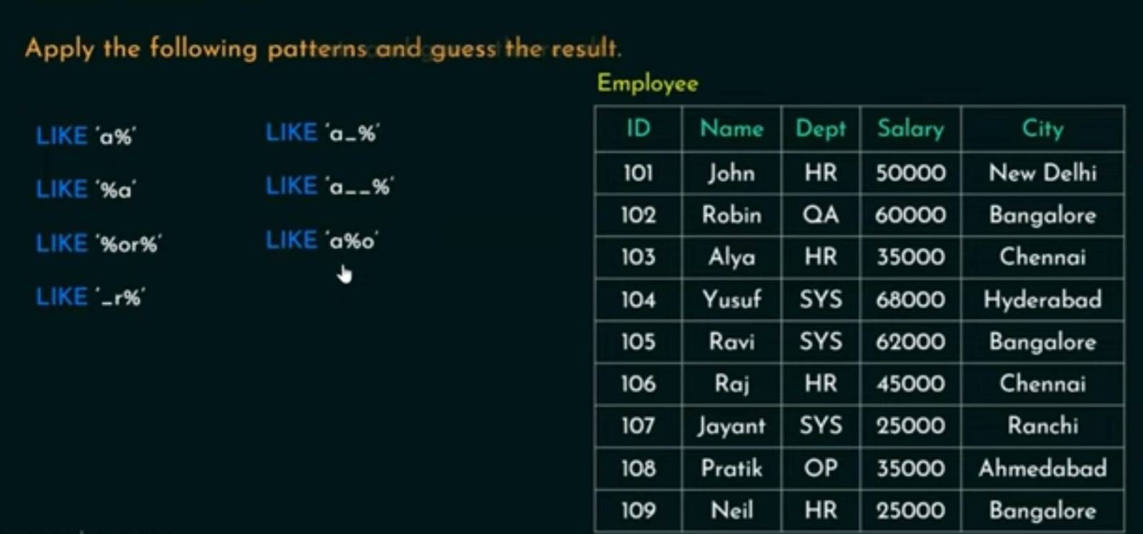

Slide 59
ORDER BY Clause
The ORDER BY is used to sort the result-set in ascending (ASC) or descending order (DESC).
By default it sorts the data in ascending order.
Syntax:
SELECT column_name FROM table_name ORDER BY column_name ASC/DESC;
SELECT * FROM employee ORDER BY Age DESC;
Emp_id | Emp_name | Age
2 | Sara | 45
1 | Nick | 35
3 | Jack | 30

Slide 60
Insert Values in table
The INSERT INTO statement is used to insert new records in a table.
Syntax
INSERT INTO TABLE_NAME(column1, column2, column3, …. Column N) values(value1, value2, value3,………value N);
Example
INSERT INTO customer(custID, CustName, age city, salary) values(1, ’sai’ ,26, ’delhi’, 9000), (2,’varun’ ,28,’pune’, 10000);
Or it can be written as
INSERT INTO customer values(1, ’sai’ ,26, ’delhi’, 9000);
INSERT INTO customer values(2,’varun’ ,28,’pune’, 10000);

Slide 61
Update Values In Table
The UPDATE command is used to update existing rows in a table.
Syntax
UPDATE TABLE_NAME
SET “column_name1”, “column_name2”=‘value2’ WHERE “ID”=‘value’
Example
UPDATE CUSTOMER
SET Custname=‘xam’, age=32 WHERE custID=4;

Slide 62
Delete Values in table
The DELETE statement is used to delete existing record in a table.
Syntax
DELETE FROM table_name WHERE condition;
Example
DELECT FROM customer WHERE custID = 3;

Slide 63
Create database education institute is managing the online course enrollment system Student can enroll maximum of six courses of their choice and a maximum student to be enrolled to any course is 60.We store student details like name, USN, semester and several addresses, course details like unique title, unique id and credits.
create database online_course;
show databases;
use online_course;
create table students(usn varchar(10) primary key, name varchar(50) not null, semester int , address varchar(100));

Slide 64
create table courses(course_id int primary key, course_title varchar(50) not null, credits int);
create table enroll( usn varchar(10), course_id int not null, foreign key(usn) references students (usn), foreign key(course_id) references courses(course_id), primary key(usn, course_id));
show tables;
insert into students values (‘1ay22ai25’, ‘Aditya’,6, ‘Rajajinagar’);
insert into students values (‘1ay22ai13’, ‘vidhya’,4, ‘Nagasandra’);
insert into students values (‘1ay22ai17’, ‘tasrin’,7, ‘Mahalakshmi ’);
insert into students values (‘1ay22ai100’, ‘Divya’,3, ‘Dasarahalli’);
select * from students;

Slide 65
insert into courses values (3,’dbms’, 5);
insert into courses values (2,’AI’, 3);
insert into courses values (1,’ADA’, 4);
select * from courses;
insert into enroll values(‘1ay22ai25’, 1);
insert into enroll values(‘1ay22ai13’, 3);
insert into enroll values(‘1ay22ai100’, 2);
insert into enroll values(‘1ay22ai13’, 1);
Select * from enroll;

